Slide 1
Unit 7 Series-Parallel Circuits
Part C: Power Dissipation in Series-Parallel Circuits

Slide 2
What will you learn?
How power is distributed in a series-parallel circuit.

Slide 3
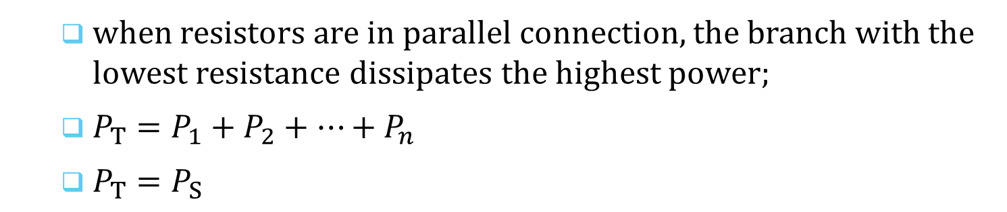
Power calculations in Series-Parallel Circuits
We will use an example to illustrate that
when resistors are in parallel connection, the branch with the lowest resistance dissipates the highest power;
$P_{T}=P_{1}+P_{2}+⋯+P_{n}$
$P_{T}=P_{S}$

Slide 4

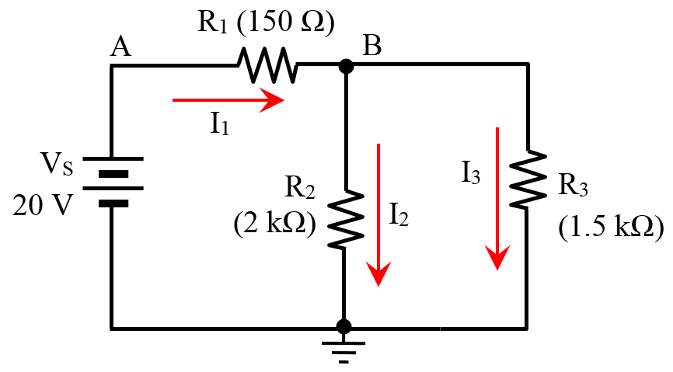



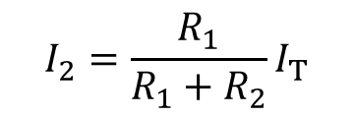

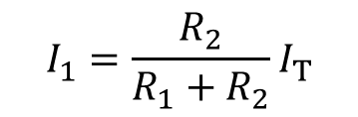

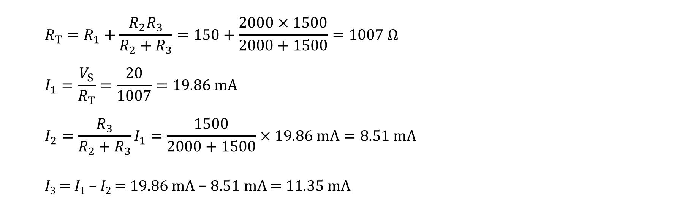

Example 1: Calculate the power dissipated in each of the resistors and the power delivered by the supply.
$$R_{T}=R_{1}+\frac{R_{2}R_{3}}{R_{2}+R_{3}}=150+\frac{2000×1500}{2000+1500}=1007 Ω$$
$$I_{1}=\frac{V_{S}}{R_{T}}=\frac{20}{1007}=19.86 mA$$
$$I_{2}=\frac{R_{3}}{R_{2}+R_{3}}I_{1}=\frac{1500}{2000+1500}×19.86 mA=8.51 mA$$
I₃ = I₁ – I₂ = 19.86 mA − 8.51 mA = 11.35 mA
$$I_{1}$$
$$R_{1}$$
CDR for 2 parallel resistors:
$$I_{1}=\frac{R_{2}}{R_{1}+R_{2}}I_{T}$$
$$I_{T}$$
CDR in Unit 6
$$I_{n}=\frac{R_{n}}{R_{n}}I_{T}$$
$$I_{2}=\frac{R_{1}}{R_{1}+R_{2}}I_{T}$$
$$I_{2}$$
$$R_{2}$$

Slide 5

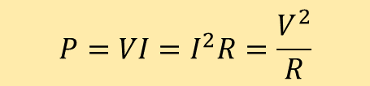
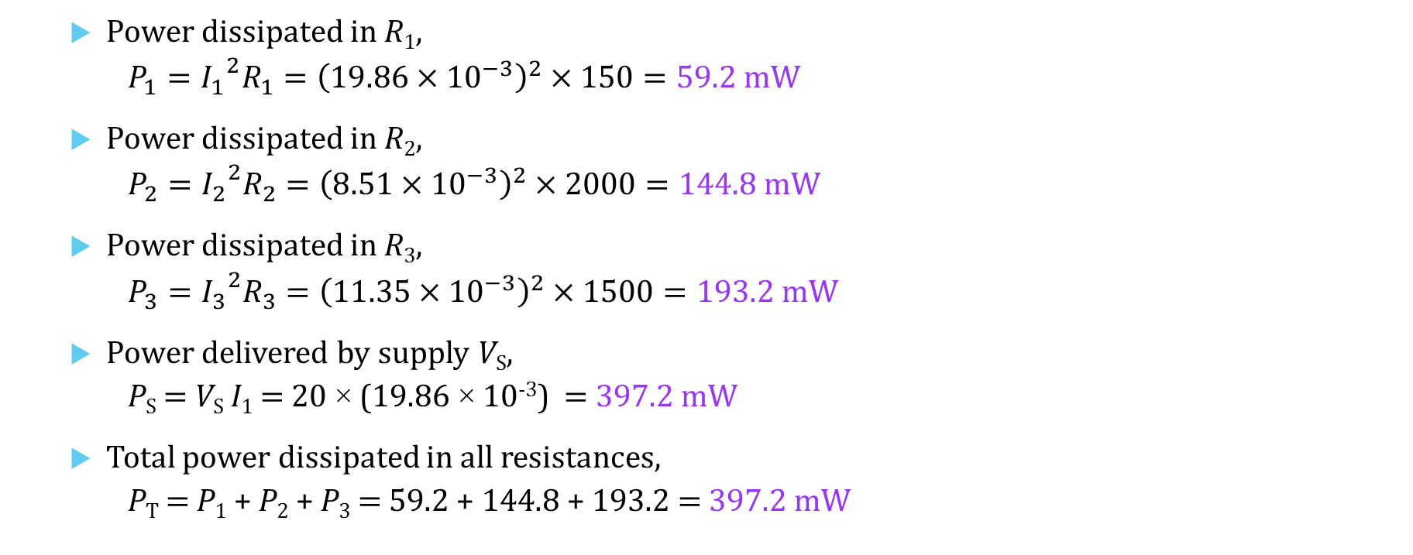
Example 1: Calculate the power dissipated in each of the resistors and the power delivered by the supply.
Power dissipated in R₁,
$P_{1}={{I_{1}}^{2}R}_{1}={\left(19.86×{10}^{−3}\right)}^{2}×150=59.2 mW$
Power dissipated in R₂,
$P_{2}={{I_{2}}^{2}R}_{2}={\left(8.51×{10}^{−3}\right)}^{2}×2000=144.8 mW$
Power dissipated in R₃,
$P_{3}={{I_{3}}^{2}R}_{3}={\left(11.35×{10}^{−3}\right)}^{2}×1500=193.2 mW$
Power delivered by supply V_{S},
P_{S} = V_{S} I₁ = 20 × (19.86 × 10⁻³) = 397.2 mW
Total power dissipated in all resistances,
P_{T} = P₁ + P₂ + P₃ = 59.2 + 144.8 + 193.2 = 397.2 mW
$$P=VI=I^{2}R=\frac{V^{2}}{R}$$

Slide 6
You have learned that
when resistors are in parallel connection, the branch with lowest resistance dissipates the highest power;
total power dissipation of any circuit is always equal to the sum of all power dissipated by individual components; and
total power dissipation of any circuit is always equal to the power delivered from the supply.

Slide 7
Coming Up Next
Superposition Theorem

